Slide 1


Sharing Smart Home Devices: From the perspective of AirBnB Host
Authors: Rajib Dey, Sayma Sultana

Slide 2
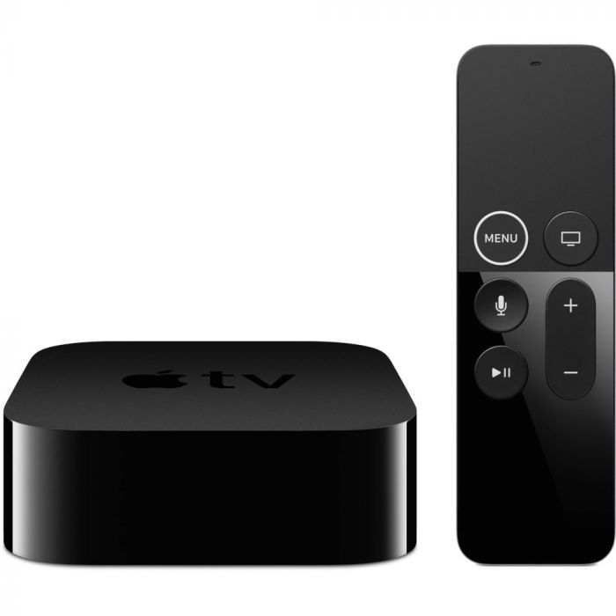
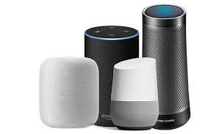
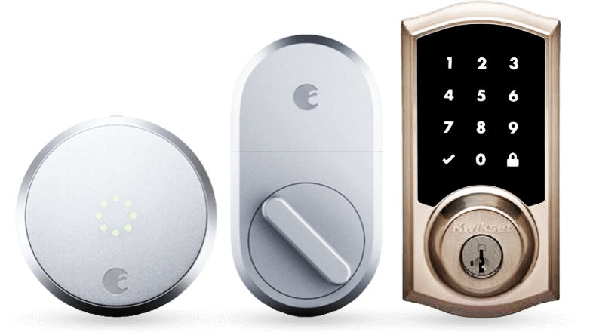
Introduction
AirBnB covers more than 81,000 cities and 191 countries worldwide.
Smart home devices to tackle security concern and maintenance.
Smart speaker
Smart lock & doorbell
Media Streamer
Notes:
- Share economy is an economic system in which assets or services are shared between individuals people, either free or for a fee, typically by means of the Internet.
Airbnb has been very popular for sharing homespace. As hosts are sharing their space with almost stranger people whom they know only by internet, it arises some security concerns. HOsts are using different smart home or IoT devices in their property to tackle security concerns and provide better care for gusts.
Smart home or IoT devices are computing devices connected with internet. They are being pervasive in our day to day life. In 2018 , 1/3 of US households have IoT devices in there homes. Like smart doorbell, camera, thermostat etc.
So smart doorbell with attached video camera for monitoring who are coming to house, whetehr any illegal activities are occcured , whether any guests left light/fan turned on etc.
-Smart home or IoT devices are being pervasive in our day to day life. In 2018 , 1/3 of US households have IoT devices in there homes. As there is a increase in IoT devices, it is increasingly being made for the consumption of multiple people. But the sharing control are not upto the mark, which is why users do not feel at ease while sharing. Even when they know each other. - AirBnB has been the most popular marketplace for renting out property. Home owners are using multiple IoT devices to ensuring their security , maintenance of property , energy saving etc. Moreover, sharing smart home devices with guests will offer guests some privileges and add to the property value, on the contrary it also has some risks.As in an AirBnB, if the owner uses
Smart speaker:At that price, it's a nice convenience your guests can enjoy. They'll be able to ask Alexa or Google Assistant for nearby restaurants or coffee shops, the weather and other things, just like if they were home. And as an Airbnb host, you can create an Alexa skill that gives your guests all sorts of information, like the Wi-Fi password and other things they may need to know about the home.
With a smart lock, like those from August or Schlage, you can provide your guests with a temporary access code that begins with check-in and expires after the check-out date and time. Guests can enter any time at midnight after flight, don’t need any paperwork etc
Give your guests something to do after they've spent a long day travelling around with a media streamer. are all affordable ways to give your guests some entertainment without running such a high risk of theft.

Slide 3
Motivation
Sharing smart home devices with differently related people imposes some issues and concerns
AirBnB hosts are using smart home devices
Our Research
Issues on sharing smart home devices
Granting safe access to strangers to AirBnB property via IoT Devices
Notes:
Where research has been done on that are the concerns on sharing IoT devices with people of home – teenager, children, spouse and people outside of home and security and privacy concerns regarding sharing Iot devices. We focus on the sharing scenario of IoT devices in smart home economy context. We have selected airBnB as it is the most popular. //
ando share IoT As there is a increase in IoT devices, it is increasingly being made for the consumption of multiple people. But the sharing control are not upto the mark, which is why users do not feel at ease while sharing. Even when they know each other. - As in an AirBnB, if the owner uses

Slide 4
Research Questions
RQ1 : What smart home devices are AirBNB hosts currently using on their properties and for what purpose?
RQ2: What are the benefits and concerns AirBNB hosts has?
RQ3: What unique needs do AirBNB hosts have for managing and sharing access control to their smart home devices with AirBNB guests?
Notes:
To know how airbnb hosts are sharing smart homes devices currently and demand on sharing smart home devices in future in share economy context, we impose three questions -

Slide 5
Literature Review
We can split our Literature Review in 2 ways
Smart Home Access Control and Privacy
2. Smart Home for AirBnB

Slide 6
Literature Review
Smart Home Access Control and Privacy
How sharing happens within a trusted circle? He et al. discussed how sharing of IoT devices inside a home differs based on relationships, time of the day, scenarios, location of the device, etc. [2].
An empirical study on 15 families done by Brush et al. [3] reveals that family members trust each other while keeping separate profiles on IoT devices. Reason: Block strangers with malicious intent.

Slide 7
Literature Review
Smart Home Access Control and Privacy
Sharing is complicated Most of the smart home devices are designed just like a personal device[2]. Control systems can be so complicated that the end-user sensed that they have less control [4]. Page et al [5] discuss that consumer grade IoT devices are not user-centric and have less control over it. Giving guests access to your IoT device in a smart home with specific with policies are important and complex task [6] [7]. It’s complex, because of the varied amount of data and trust users have between themselves [8]. User concern on security & Privacy vary depending on the relationships such as guests [6], roommates [8], and children [9] [10]. Trust plays a major factor even when sharing IoT devices among neighbors can help increase the security. [11]

Slide 8
Literature Review
Smart Home Access Control and Privacy
Sharing has privacy and security issues Sharing has privacy and security concern to users [12] [13]. Trust for the devices is also important as when the user is away from home, the access control of the home IoT devices has to be trustworthy enough to operate on their own [14].

Slide 9
Literature Review
Smart Home Access Control and Privacy
Solutions to this problems Mazurek et al. [15] show that most of the time the user needs a complex access control policy and they try to achieve that by using makeshift methods.
Kostianinen et al. [7], tried to introduce an access control policy for smart home networks limited to family members which would pose a nominal amount of burden on the end-user by testing a few access control policies. Another research by Dixon et al. [16] reveals, access-control policies based on time (for guests), special preventive measures for highly sensitive devices like cameras and locks, limiting of application’s access to devices. Providing users the information about the data being monitored by all the devices[17].

Slide 10
Literature Review
2. Smart Home for AirBnB
Researchers from Umass Amherst [1] proposed Preserving IoT Privacy in Sharing Economy (or AirBnB) using Blockchain technology. We take an HCI approach to this by asking the hosts what they want.

Slide 11

Methods
Pre Screening Survey
( 10 min)
10 hosts with 2+ smart home devices
How many devices?
Which devices ?
Which capabilities?
50+ airBnB hosts
Notes:
(contact host, invite, questions of survey, Why survey ) For our research we will execute both quantitative and qualitative research methods. one pre screening survey and another follow up interview. At first we will contact Air bnb hosts through airbnb sites, describe our study and purpose and share our survey form. We will make a small set of questions for survey using google from for airBNB hosts and ask them whether they share any smart home devices e.g. smart lock, indoor camera, light , burglar alarm with the hosts, if yes then how many and which devices and which capabilities. We are conducting this survey as We want to exclude the hosts for interview who does not share at least 2 smart home IoT devices with their guests. As we wont get any valuable data from the hosts who does not possess or share IoT devices with hosts. Thus we will know how many devices, which devices are currently being shared in smart home economy, what is the purpose.

Slide 12
Methods
Follow up interview
(30 min)
Data
10 hosts with 2+ smart home devices
Do they share?
Sharing easy or hard?
Want more access control?
Any security concern?
Any incident inspired to share?
Notes:
(phone call, 30 min, questions, purpose) Then in interview we will dive into more detail via phone call, at most 30 minutes(read interview questions) what do they think about if they share their devices whether those will increase guests visit comfortable and easy, does sharing increase their security concerns, any challenge they have faced while sharing those devices, any demands that should have been in access control for making access control more granular. Like there is no need to control smart lights, but for voice assistant they wont share placing online shopping
We will conduct 10 follow up interviews with the selected hosts and ask them questions like – (see ineterview qs) what aceesses they share, whether they have any concern on security or privacy. Any demand they have for sharing smart home devices with guests. Thus we will get quantitative data about their current situation of sharing and demands for future sharing.

Slide 13
Data Analysis
Transcribe interview
Coding to common theme
Code aggregation
Notes:
Transcribe interviews using Google translator.
Classify their benefits – (ghapla)guests satisfaction, for providing comfort and care, adding property value, save energy, security ensurance, easy for maintenance etc.
what type of security concern – like lose of control, any incident that triggered their sharing decision, do they want more access control, what type of demand for access control
Then we will aggregate their data based on common theme and get result

Slide 14
Project Timeline
Proposal draft with IRB approval
Proposal draft with initial data
Collecting survey responses
Processing response & selecting interviewees
Initial data analysis
Final draft
Conducting interviews
Getting IRB approval
Final result
Invitation to survey
29 Oct
30 Oct
8 Nov
10 Nov
15 Nov
21 Nov
30 Nov
3 Dec

Slide 15
Contribution
Better understanding of the status quo of smart home devices in AirBnB.
Notes:
We will provide a better understanding of the status quo
On how smart home devices are being used in AirBnB by the Host
And what what kind of sharing access control they want in future

Slide 16
References
[1] M. N. Islam and S. Kundu. Poster abstract: Preserving iot privacy in sharing economy via smart contract. In 2018 IEEE/ACM Third International Conference on Internet-of-Things Design and Implementation (IoTDI), pages 296–297, April 2018. [2] Weijia He, Maximilian Golla, Roshni Padhi, Jordan Ofek, Markus Dürmuth, Earlence Fernandes, and Blasé Ur. Rethinking access control and authentication for the home internet of things (iot). In 27th fUSENIXg Security Symposium (USENIX Security 18), pages 255–272, 2018. [3] A.J. Brush and Kori Inkpen. Yours, mine and ours? sharing and use of technology in domestic environments. In Ubicomp 2007. Springer, September 2007.
[4] Dave Randall. Living Inside a Smart Home: A Case Study, pages 227–246. Springer London, London, 2003.
[5] Xinru Page, Paritosh Bahirat, Muhammad I. Safi, Bart P. Knijnenburg, and Pamela J. Wisniewski. The internet of what?: Understanding differences in perceptions and adoption for the internet of things. IMWUT, 2:183:1–183:22, 2018. [6] Matthew Johnson. Usability of security management: Defining the permissions of guests. In Bruce Christianson, Bruno Crispo, James A. Malcolm, and Michael Roe, editors, Security Protocols, pages 284–285, Berlin, Heidelberg, 2009. Springer Berlin Heidelberg. [7] K. Kostiainen, O. Rantapuska, S. Moloney, V. Roto, U. Holmstrom, and K. Karvonen. Usable access control inside home networks. In 2007 IEEE International Symposium on a World of Wireless, Mobile and Multimedia Networks, pages 1–6, June 2007. [8] Vassilios Lekakis, Yunus Basagalar, and Pete Keleher. Don’t trust your roommate or access control and replication protocols in "home" environments. In Proceedings of the 4th USENIX Conference on Hot Topics in Storage and File Systems, HotStorage’12, pages 12–12, Berkeley, CA, USA, 2012. USENIX
Association.

Slide 17
References
[9] Tamara Denning, Tadayoshi Kohno, and Henry M. Levy. Computer security and the modern home. Commun. ACM, 56(1):94–103, January 2013.
[10] Stuart Schechter. The user is the enemy, and (s)he keeps reaching for that bright shiny power button! In Proceedings of the Workshop on Home Usable Privacy and Security (HUPS), July 2013. [11] A.J. Brush, Jaeyeon Jung, Ratul Mahajan, and Frank Martinez. Digital neighborhood watch: Investigating the sharing of camera data amongst neighbors. In CSCW 2013. ACM, February 2013. [12] Pardis Emami-Naeini, Sruti Bhagavatula, Hana Habib, Martin Degeling, Lujo Bauer, Lorrie Faith Cranor, and Norman Sadeh. Privacy expectations and preferences in an iot world. In Proceedings of the Thirteenth USENIX Conference on Usable Privacy and Security, SOUPS ’17, pages 399–412, Berkeley, CA, USA, 2017. USENIX Association. [13] Eric Zeng, Shrirang Mare, and Franziska Roesner. End user security and privacy concerns with smart homes. In Thirteenth Symposium on Usable Privacy and Security (SOUPS 2017), pages 65–80, 2017.
[14] W. Keith Edwards and Rebecca E. Grinter. At home with ubiquitous computing: Seven challenges. In Proceedings of the 3rd International Conference on Ubiquitous Computing, UbiComp ’01, pages 256–272, Berlin, Heidelberg, 2001. Springer-Verlag.
[15] Michelle L. Mazurek, J. P. Arsenault, Joanna Bresee, Nitin Gupta, Iulia Ion, Christina Johns, Daniel Lee, Yuan Liang, Jenny Olsen, Brandon Salmon, Richard Shay, Kami Vaniea, Lujo Bauer, Lorrie Faith Cranor, Gregory R. Ganger, and Michael K. Reiter. Access control for home data sharing: Attitudes, needs and practices. In Proceedings of the SIGCHI Conference on Human Factors in Computing Systems, CHI ’10, pages 645–654, New York, NY, USA, 2010. ACM.

Slide 18
References
[16] Colin Dixon, Ratul Mahajan, Sharad Agarwal, A.J. Brush, Bongshin Lee, Stefan Saroiu, and Paramvir Bahl. An operating system for the home. In Presented as part of the 9th USENIX Symposium on Networked Systems Design and Implementation (NSDI 12), pages 337–352, San Jose, CA, 2012. USENIX.
[17] Simon Moncrieff, Svetha Venkatesh, and Geoff West. Privacy and the access of information in a smart house environment. In Proceedings of the 15th ACM International Conference on Multimedia, MM ’07, pages 671–680, New York, NY, USA, 2007. ACM.

Slide 19
Questions ?

